Slide 1
Introduction to CPCAPI

Slide 2
CPCAPI
= Creation Platform C/C++ API
Allows to integrate apps through C++
Turns Python Applications to Plugins

Slide 3
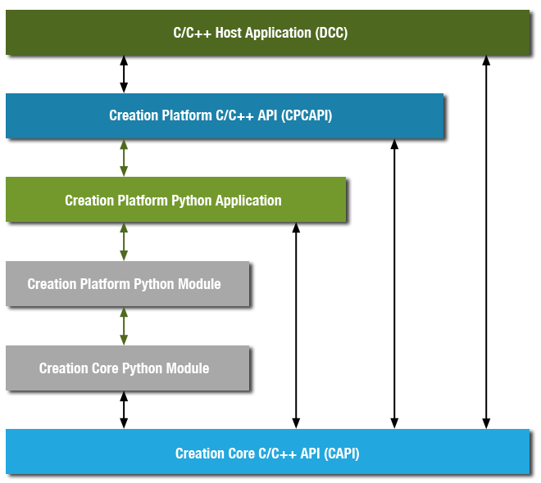
CPCAPI - Structure

Slide 4
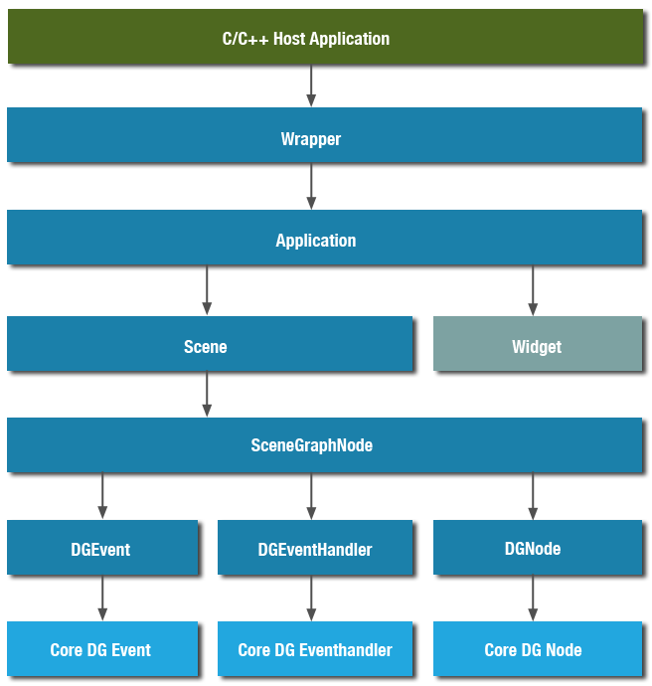
CPCAPI – Access Hierarchy

Slide 5
Integrated Application
Declaring Widgets
Declaring Manipulations
Declaring Commands

